Slide 1

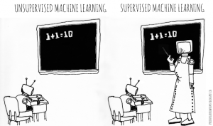
Unsupervised ML

Slide 2
Supervised learning vs. unsupervised learning
Supervised learning: discover patterns in the data that relate data attributes with a target (class) attribute.
These patterns are then utilized to predict the values of the target attribute in future data instances.
Unsupervised learning: The data have no target attribute.
We want to explore the data to find some intrinsic structures in them.

Slide 3
Clustering
Clustering is a technique for finding similarity groups in data, called clusters. I.e.,
it groups data instances that are similar to (near) each other in one cluster and data instances that are very different (far away) from each other into different clusters.
Clustering is often called an unsupervised learning task as no class values denoting an a priori grouping of the data instances are given, which is the case in supervised learning.
Due to historical reasons, clustering is often considered synonymous with unsupervised learning.
In fact, association rule mining is also unsupervised
This chapter focuses on clustering.

Slide 4
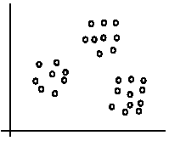
An illustration
The data set has three natural groups of data points, i.e., 3 natural clusters.

Slide 5
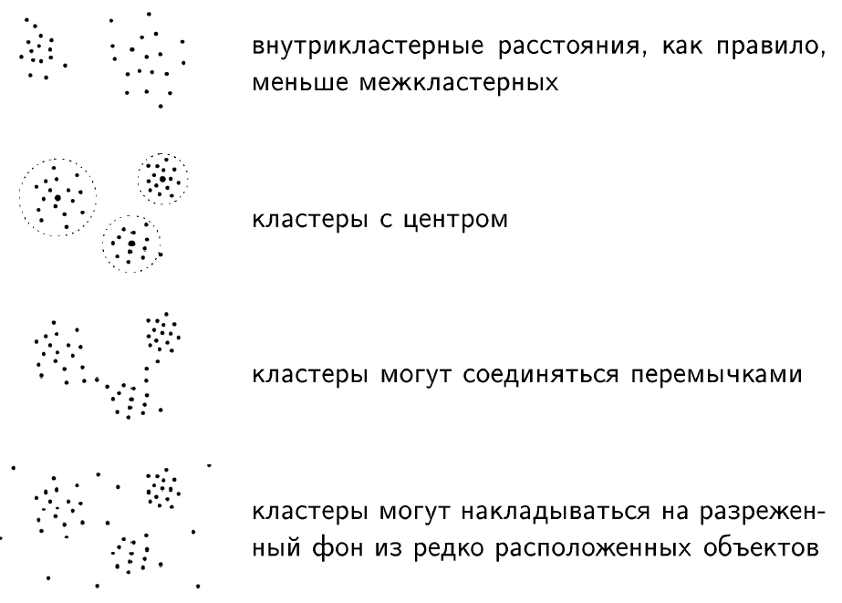
Types of clustered structures

Slide 6
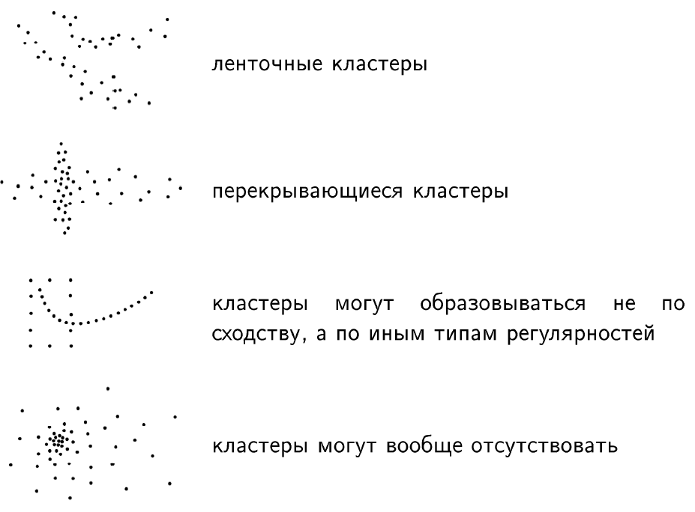
Types of clustered structures

Slide 7
What is clustering for?
Let us see some real-life examples
Example 1: groups people of similar sizes together to make “small”, “medium” and “large” T-Shirts.
Tailor-made for each person: too expensive
One-size-fits-all: does not fit all.
Example 2: In marketing, segment customers according to their similarities
To do targeted marketing.

Slide 8
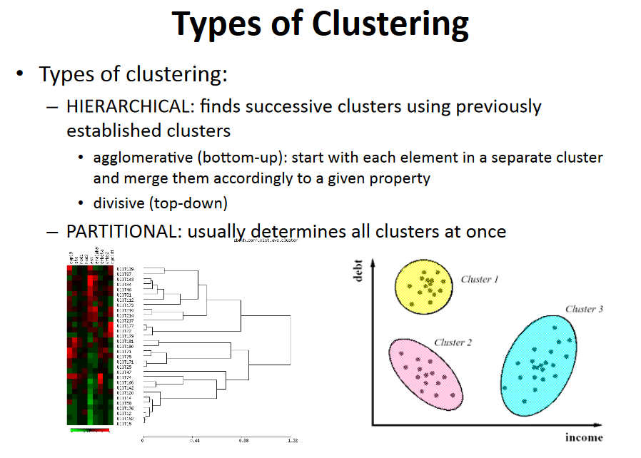

Slide 9
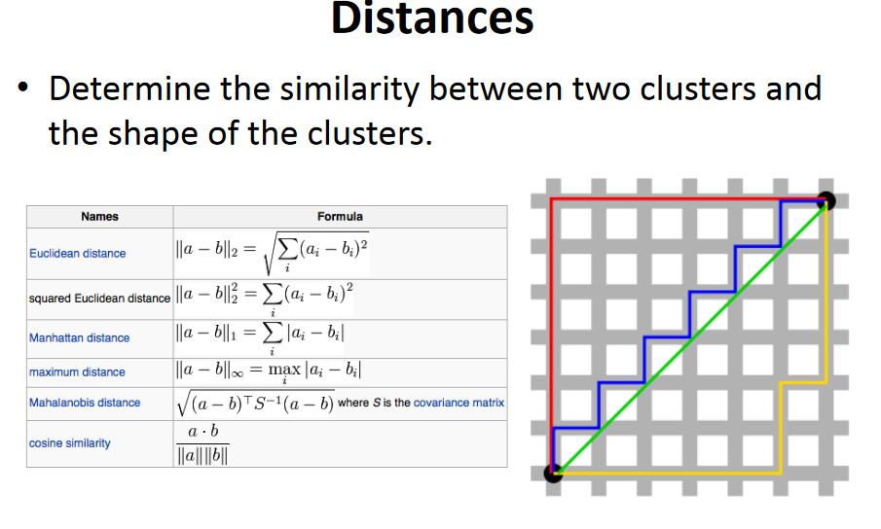

Slide 10
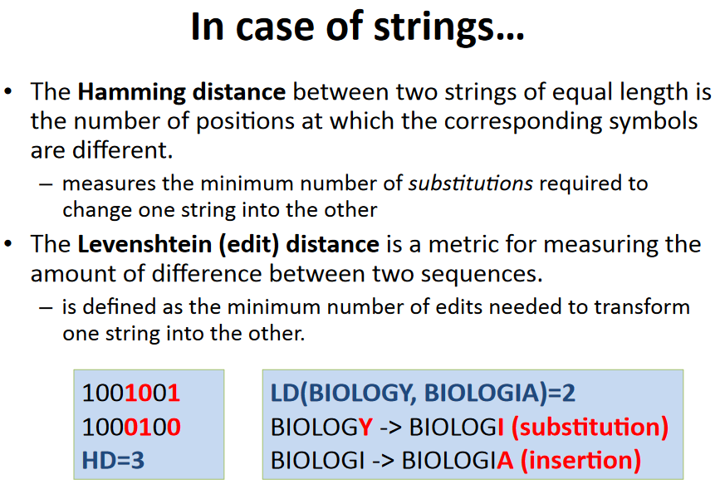

Slide 11
What is clustering for? (cont…)
Example 3: Given a collection of text documents, we want to organize them according to their content similarities,
To produce a topic hierarchy
In fact, clustering is one of the most utilized data mining techniques.
It has a long history, and used in almost every field, e.g., medicine, psychology, botany, sociology, biology, archeology, marketing, insurance, libraries, etc.
In recent years, due to the rapid increase of online documents, text clustering becomes important.

Slide 12
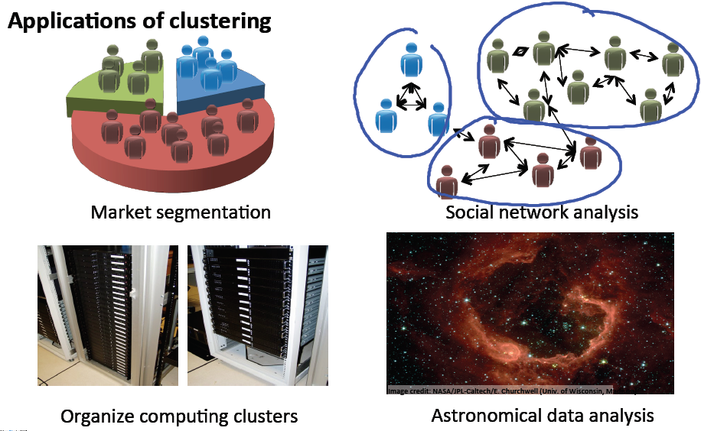

Slide 13
Aspects of clustering
A clustering algorithm
Partitional clustering
Hierarchical clustering
…
A distance (similarity, or dissimilarity) function
Clustering quality
Inter-clusters distance ⇒ maximized
Intra-clusters distance ⇒ minimized
The quality of a clustering result depends on the algorithm, the distance function, and the application.

Slide 14
K-means clustering
K-means is a partitional clustering algorithm
Let the set of data points (or instances) D be
{x₁, x₂, …, x_{n}},
where x_{i} = (x_{i1}, x_{i2}, …, x_{ir}) is a vector in a real-valued space X ⊆ R^{r}, and r is the number of attributes (dimensions) in the data.
The k-means algorithm partitions the given data into k clusters.
Each cluster has a cluster center, called centroid.
k is specified by the user

Slide 15
K-means algorithm
Given k, the k-means algorithm works as follows:
Randomly choose k data points (seeds) to be the initial centroids, cluster centers
Assign each data point to the closest centroid
Re-compute the centroids using the current cluster memberships.
If a convergence criterion is not met, go to 2).

Slide 16
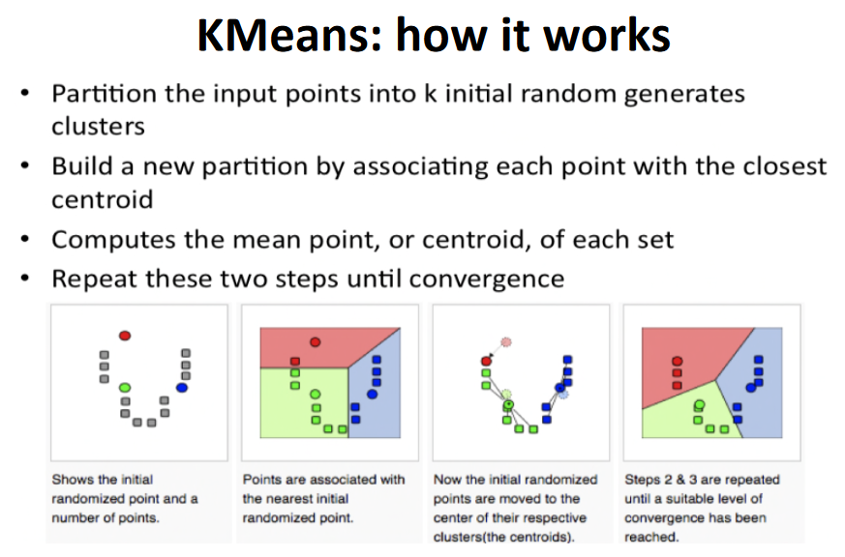

Slide 17
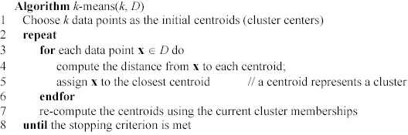
K-means algorithm – (cont …)

Slide 18
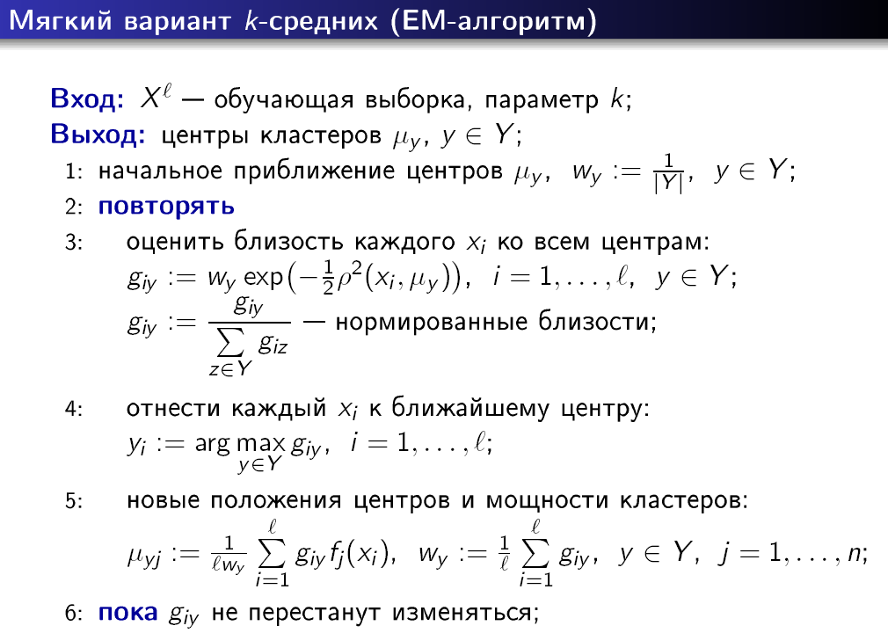

Slide 19
Stopping/convergence criterion
no (or minimum) re-assignments of data points to different clusters,
no (or minimum) change of centroids, or
minimum decrease in the sum of squared error (SSE),
C_{i} is the jth cluster, m_{j} is the centroid of cluster C_{j} (the mean vector of all the data points in C_{j}), and dist(x, m_{j}) is the distance between data point x and centroid m_{j}.
(1)

Slide 20
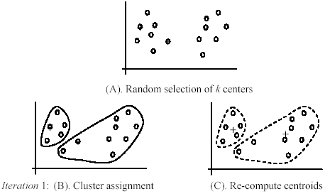
An example
+
+

Slide 21
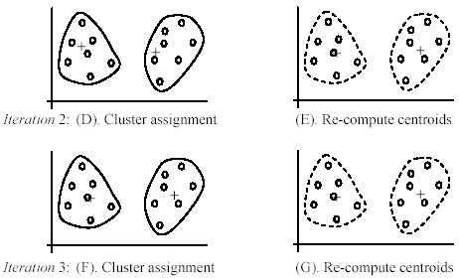
An example (cont …)

Slide 22
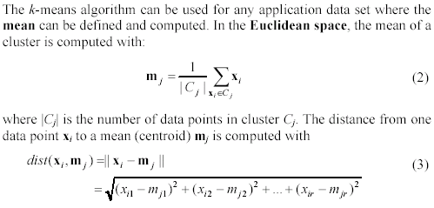
An example distance function

Slide 23
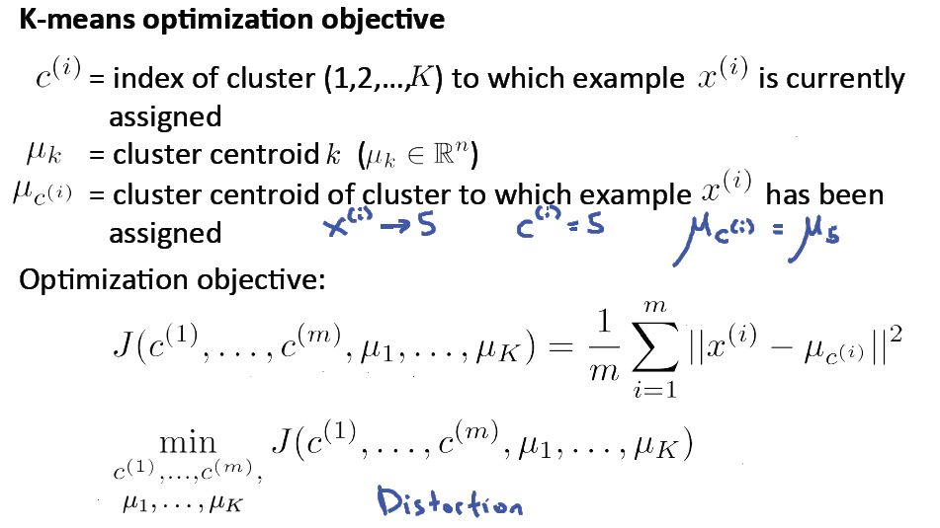

Slide 24
Strengths of k-means
Strengths:
Simple: easy to understand and to implement
Efficient: Time complexity: O(tkn),
where n is the number of data points,
k is the number of clusters, and
t is the number of iterations.
Since both k and t are small. k-means is considered a linear algorithm.
K-means is the most popular clustering algorithm.
Note that: it terminates at a local optimum if SSE is used. The global optimum is hard to find due to complexity.

Slide 25
Weaknesses of k-means
The algorithm is only applicable if the mean is defined.
For categorical data, k-mode - the centroid is represented by most frequent values.
The user needs to specify k.
The algorithm is sensitive to outliers
Outliers are data points that are very far away from other data points.
Outliers could be errors in the data recording or some special data points with very different values.

Slide 26
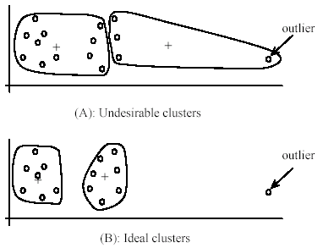
Weaknesses of k-means: Problems with outliers

Slide 27
Weaknesses of k-means: To deal with outliers
One method is to remove some data points in the clustering process that are much further away from the centroids than other data points.
To be safe, we may want to monitor these possible outliers over a few iterations and then decide to remove them.
Another method is to perform random sampling. Since in sampling we only choose a small subset of the data points, the chance of selecting an outlier is very small.
Assign the rest of the data points to the clusters by distance or similarity comparison, or classification

Slide 28
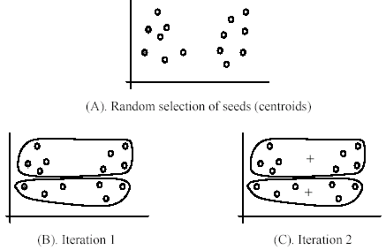
Weaknesses of k-means (cont …)
The algorithm is sensitive to initial seeds.

Slide 29
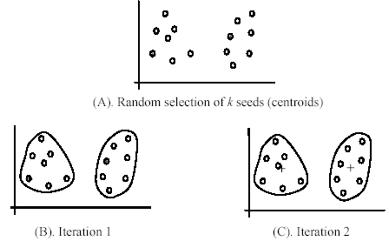
Weaknesses of k-means (cont …)
If we use different seeds: good results
There are some methods to help choose good seeds

Slide 30
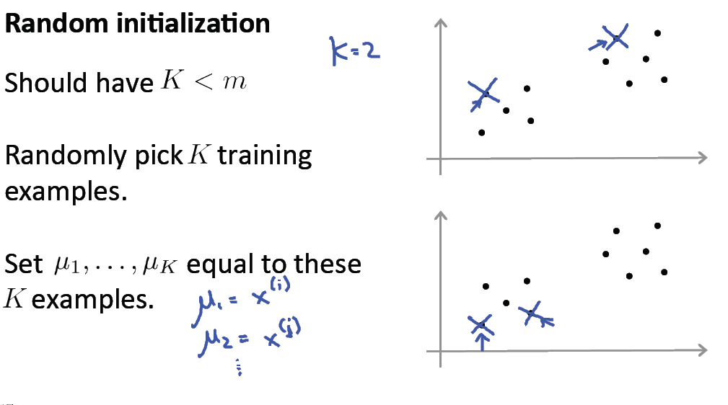

Slide 31
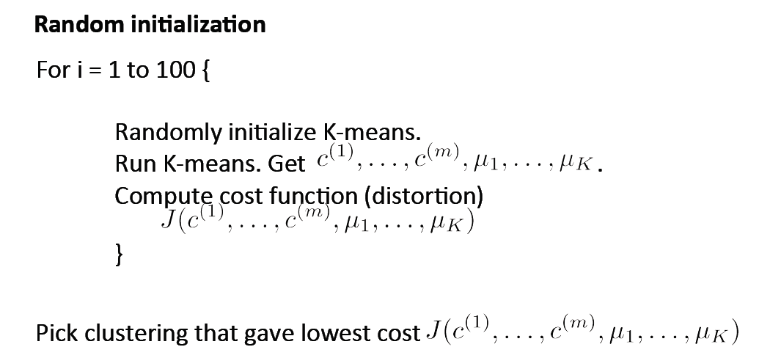

Slide 32
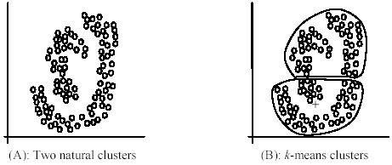
Weaknesses of k-means (cont …)
The k-means algorithm is not suitable for discovering clusters that are not hyper-ellipsoids (or hyper-spheres).
+

Slide 33
